Slide 1
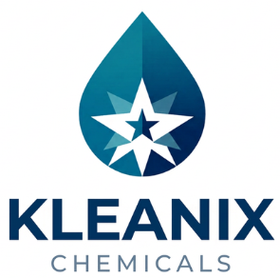


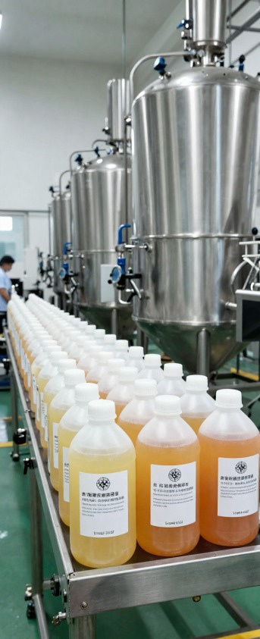


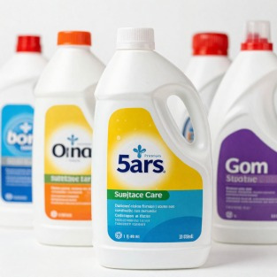
ABOUT
KLEANIX CHEMICALS
Eco Innovation
Sustainable, plant-based surfactants and eco-friendly formulations for responsible cleaning performance.
Zero Damage Formula
Non-corrosive, surface-safe formulas engineered to protect surfaces while delivering exceptional clean.
Instant Access & Delivery
KLEANIX CHEMICALS
Reliable Performance. Exceptional Clean.
Retail-ready packaging with multi-state shipping, centralized fulfillment hubs, and EDI onboarding.
Premium commercial-grade surface maintenance
solutions for residential, industrial, and
automotive sectors. Corporate Register &
Compliance Charter - Edition 2026.

Slide 2

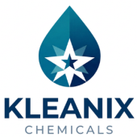
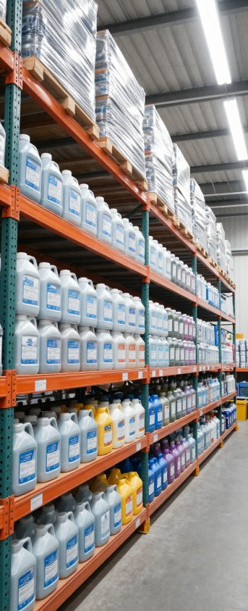


OUR KEY FEATURES
Plant-Derived Surfactant Technology
Advanced bio-based cleaning agents derived from renewable plant sources, delivering powerful degreasing without harsh chemicals.
Industrial-Grade Manufacturing Standards
Produced in Class 3 certified facilities with rigorous quality control, ensuring consistent performance across every batch.
Compliance & Safety Certification
WHY CHOOSE KLEANIX CHEMICALS
All products meet regulatory standards for commercial and residential use with full documentation and safety data sheets.
Your Trusted Chemical Partner
With advanced formulation expertise and centralized
fulfillment infrastructure, Kleanix Chemicals delivers
reliable, eco-conscious cleaning solutions at
commercial scale across multiple states.

Slide 3

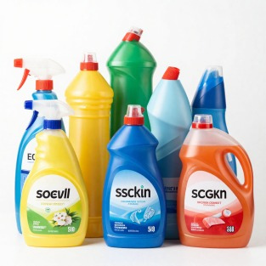
PRODUCT REGIMENS
Regimen 1: Home & Surface Care
High-efficiency floor cleaners, tile descalers, ceramic bowl cleaners, and multi-surface wash concentrates for residential and commercial spaces.
Regimen 2: Hygiene & Kitchen Care
Premium dish wash gels, drain openers, fabric wash conditioners, and glass cleansers for kitchens, laundry, and hygiene applications.
Regimen 3: Automotive Detail Systems
PRODUCT LINEUP
Professional vehicle shampoos, vinyl protectants, spray detailers, interior cleansers, and air fragrance mist atomizers for auto care.
15ProductsAcross 3 Regimens
Our 2026 portfolio features 15 specialized formulations organized into three regimens: Surface Care, Hygiene &
Kitchen, and Automotive Detailing - each engineered
for maximum performance.

Slide 4

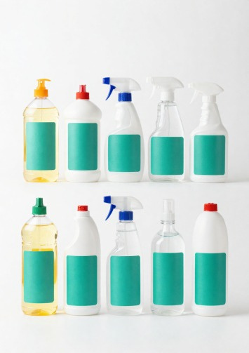
REGIMEN 1
HOME & SURFACE
CARE SOLUTIONS
01. High-Efficiency Floor Cleaner Concentrate
02. Tile & Ceramic Descaler Formula
03. Ceramic Bowl Deep Cleanser
04. Multi-Surface Wash Concentrate
05. Glass & Mirror Streak-Free Cleanser
High-efficiency floor cleaners, tile descalers, ceramic bowl cleaners, and multi-surface wash concentrates for residential and commercial spaces.

Slide 5
REGIMEN 2
Premium Hygiene, Apparel & Kitchen Care
06. Liquid Hand Cleansing Gel Matrix
07. Active Dish Wash Liquid Gel Concentrate
08. Rapid Drain Flow Opener Compound
09. Smart Liquid Fabric Wash Conditioner
10. Crystal Glass & Windscreen Cleanser
Formulated for kitchen, laundry, and personal hygiene applications. Concentrated gels and compounds deliver professional-grade results.

Slide 6

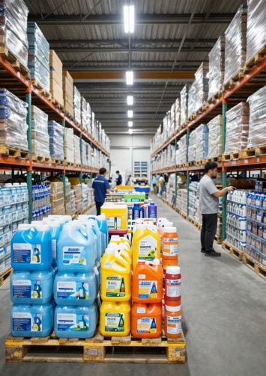
REGIMEN 3
Professional Automotive Detail Systems
11. Hi-Shine Foam Vehicle Shampoo
12. Premium Vinyl & Rubber Protectant Shield
13. Express Gloss Spray Detailer Agent
14. Fabric & Interior Surface Cleanser Spray
15. Ambient Air Fragrance Mist Atomizer
Professional-grade automotive detailing solutions for vehicle exteriors, interiors, and ambient care. Engineered for showroom-quality results.

Slide 7
CORPORATE & CONTACT INFORMATION
Manufactured & Supplied By
SIDDHJI SUPPLIER AND SERVICES
Jaipur, Rajasthan, India
Trademark
KLEANIX CHEMICALS™
Chief Operating Officer: Saurabh Tiwari
Industrial Index: Class 3 / Household & Auto Lines
Contact & Helpline
+91 7349001664 | +91 8696242412 WhatsApp Business: +91 7349001664
Centralized fulfillment hubs in Rajasthan | Multi-state vendor routing | EDI onboarding
KLEANIX CHEMICALS™ - Commercial Architecture, Fleet Maintenance & Engineering Solutions

